Slide 1

CSA0305 – DATA STRUCTURES
CAPSTONE PROJECT REVIEW 1
Improving Organ Donar-Recipient Matching Using Graph Algorithms: A Smart Organ Donation System Compared with Traditional Matching Methods
PRESENTED BY:
Sree B (192524023)
Osuru Siva Charan (192525039)
N.S.V. Trivikram (192525063)
Madineni Dhanush Kumar (192525318)
Ragul M (192524066)
GUIDED BY: Dr. Uma Priyadarsini P.S,
Professor, SIMATS Engineering

Slide 2


ABSTRACT
Background: Organ donation requires a fast and accurate matching process, but traditional methods are often slow and involve significant manual effort.
Objective: Develop a Smart Organ Donation and Recipient Matching System using Graph Algorithms to automate donor–recipient matching.
Methodology: The system uses graph algorithms to match donors and recipients based on blood group, organ type, urgency, and hospital location.
Outcome: The proposed system improves matching accuracy, reduces allocation time, enhances transparency, and supports efficient organ transplantation.

Slide 3
INTRODUCTION
Organ transplantation is a life-saving medical procedure, but finding a compatible donor quickly remains a major challenge.
Traditional organ matching systems rely on manual processes, which can be time-consuming, less efficient, and prone to delays.
The proposed Smart Organ Donation and Recipient Matching System uses Graph Algorithms to automate donor–recipient matching based on compatibility factors such as blood group, organ type, urgency, and location.
The goal of the system is to provide faster, accurate, and transparent organ allocation, improving the efficiency of the transplantation process and increasing the chances of successful transplants.

Slide 4
OBJECTIVES
Develop a Smart Organ Donation and Recipient Matching System to automate the donor–recipient matching process.
Implement Graph Algorithms to identify the most suitable recipient based on blood group, organ type, medical urgency, and hospital location.
Reduce organ allocation time and minimize manual effort through an efficient and transparent matching process.
Improve matching accuracy and fairness to support timely organ transplantation and better patient outcomes.

Slide 5
LITERATURE REVIEW
Sl No | Year | Authors | Title of the Paper | Journal Name | Algorithms | Findings | Drawbacks
1 | 2024 | Nahed Alowidi, Razan Ali, Munera Sadaqah4 | Advancing Kidney Transplantation: A Machine Learning Approach to Enhance Donor–Recipient Matching | Diagnostics | Gradient Boosting (GB) Neural Network (NN) Custom Similarity Ranking Algorithm | High matching accuracy | Private dataset restrictions
2 | 2025 | Nkansah, C. N. | Optimising Organ Donation Through Machine Learning and Blockchain: A Secure and Efficient Matching System | Ashesi University | Machine learning Blockchain | Improved matching efficiency | Extended wait times
3 | 2025 | W Pulakhandam, A Chaluvadi, VR Vallu | Smart Transplant+: A HyCARE Hybrid AI–Cloud Framework for Intelligent Donor–Recipient Matching, Workflow Automation, and Post-Transplant Optimization | Transplant Immunology | Feedforward Neural Network (FNN), Genetic Algorithm (GA), Gated Recurrent Unit (GRU) | High Matching Accuracy | High Computational Complexity
4 | 2026 | Wenzhuo Luo, Guoxu Tang, | Transforming Lung Transplantation with Artificial Intelligence: A Narrative Review from Organ Allocation to Post-Transplant Management | Journal of Thoracic Disease | Random Forest (RF), Convolutional Neural Network (CNN), Long Short-Term Memory (LSTM), XGBoost | Improved Clinical Decisions | Limited Clinical Validation
5 | 2026 | Xueqing Wang, Teresa Pont, Jordi Rello | Sex- and Age-Related Differences Among Liver Transplant Patients: A Narrative Review | Journal of Intensive Care Medicine | MELD Allocation Model, Sex-Adjusted Allocation Model | Improved Allocation Equity | Persistent Gender Disparities

Slide 6

PPROBLEM IDENTIFICATION AND ANALYSIS
Existing donor–recipient matching systems depend on private and limited datasets, reducing accessibility and scalability across healthcare organizations.
AI-based transplantation frameworks involve high computational complexity, making real-time organ allocation slower and more resource-intensive.
Current organ matching methods provide limited transparency and fairness, leading to inequalities in donor–recipient allocation.
Most existing systems focus on AI and machine learning models, with limited use of graph algorithms for efficient donor–recipient relationship analysis.
There is a need for a fast, accurate, and automated organ donation system that minimizes manual effort, reduces waiting time, and improves transplant success through optimized graph-based matching.

Slide 7
MODULES
Module 1: Donor & Recipient Registration and Medical Profile Management
Module 2: Graph-Based Organ Matching and Priority Optimization
Module 3: Smart Donor–Recipient Organ Matching and Compatibility Analysis
Module 4:Organ Request, Approval and Status Management
Module 5:Graph-Based Matching, Priority Scoring and Allocation
Module 6:Admin Monitoring, Analytics and Medical Reporting

Slide 8
DATASET USED
Secure Admin Authentication – Admin access is protected using a unique username and password.
Database-Based Credentials – Admin login details are securely maintained in the database for authentication.
Controlled Access – Only authorized administrators can access reports, donor/recipient management, and system monitoring.
Credential Management – Admin username and password can be updated directly through the database when required.

Slide 9
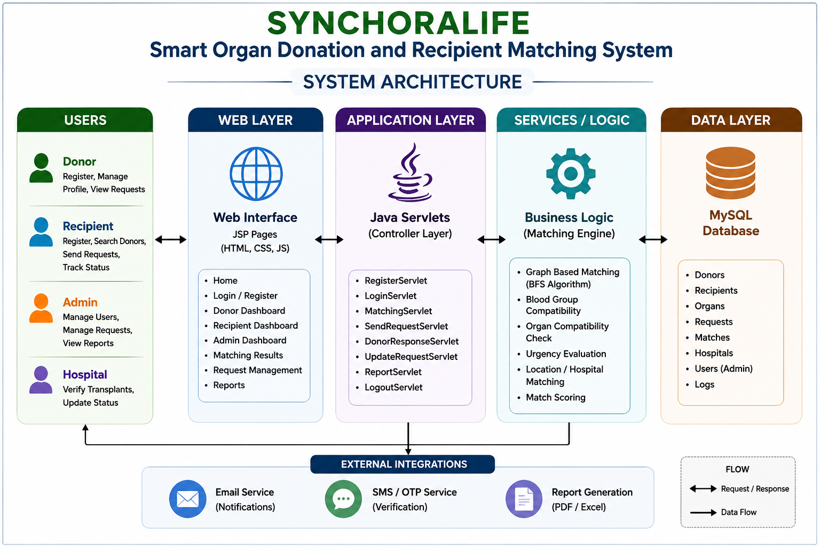
SYSTEM ARCHITECTURE

Slide 10
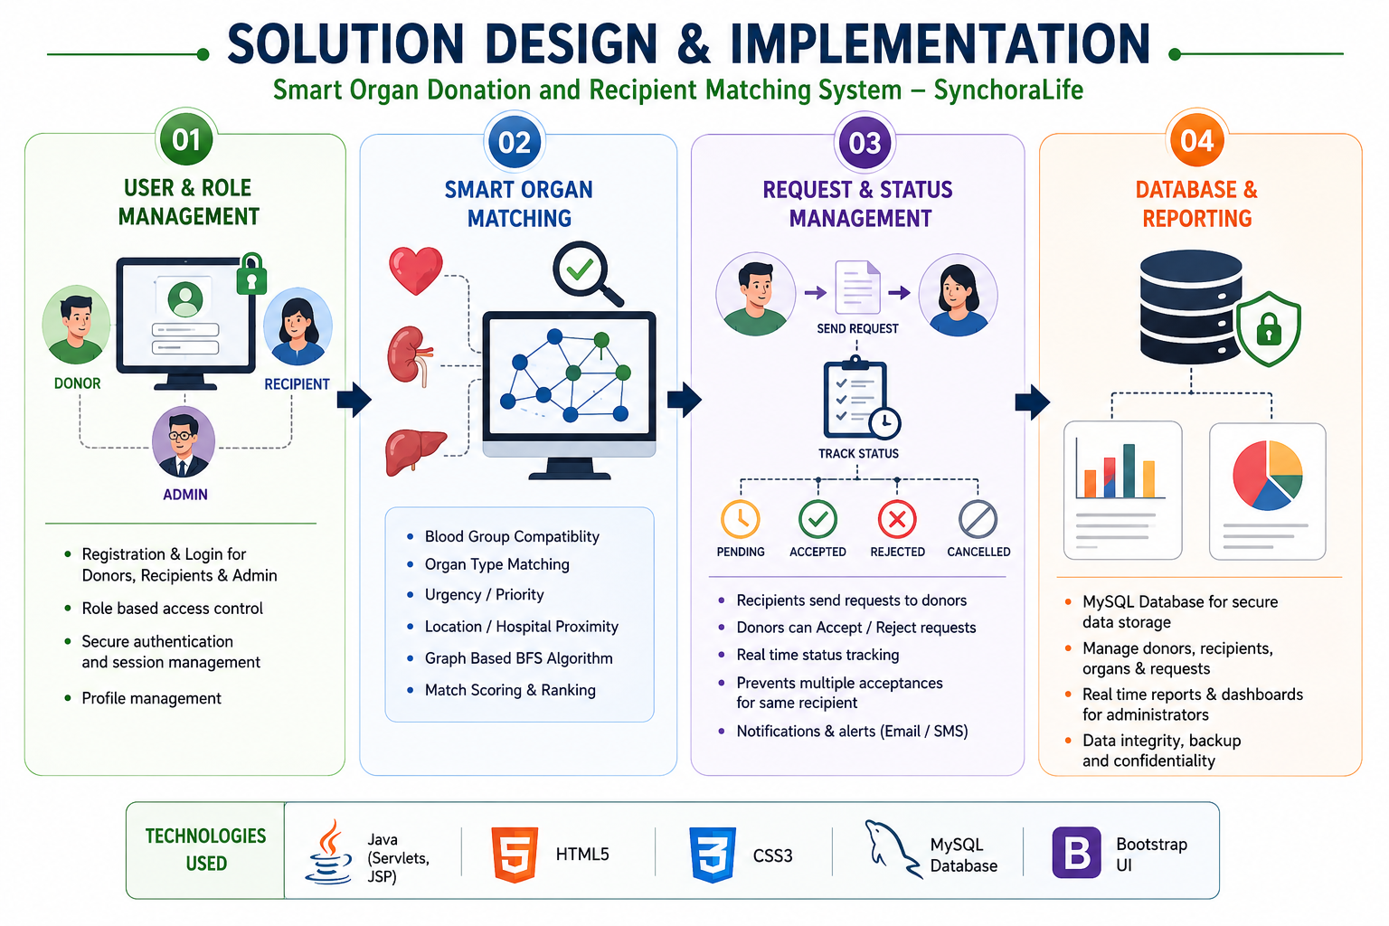
SOLUTION DESIGN AND IMPLEMENTATION
User & Role Management – Provides secure registration and login for donors, recipients, and administrators with role-based access.
Smart Organ Matching – Uses blood-group compatibility, organ type, urgency, location, and graph-based BFS matching to identify suitable donor–recipient pairs.
Request & Status Management – Enables recipients to send requests, donors to accept/reject them, and the system to track pending, accepted, rejected, and cancelled requests.
Database & Reporting – Uses MySQL to securely manage donor, recipient, organ, and request data while providing administrators with real-time reports and matching statistics.

Slide 11
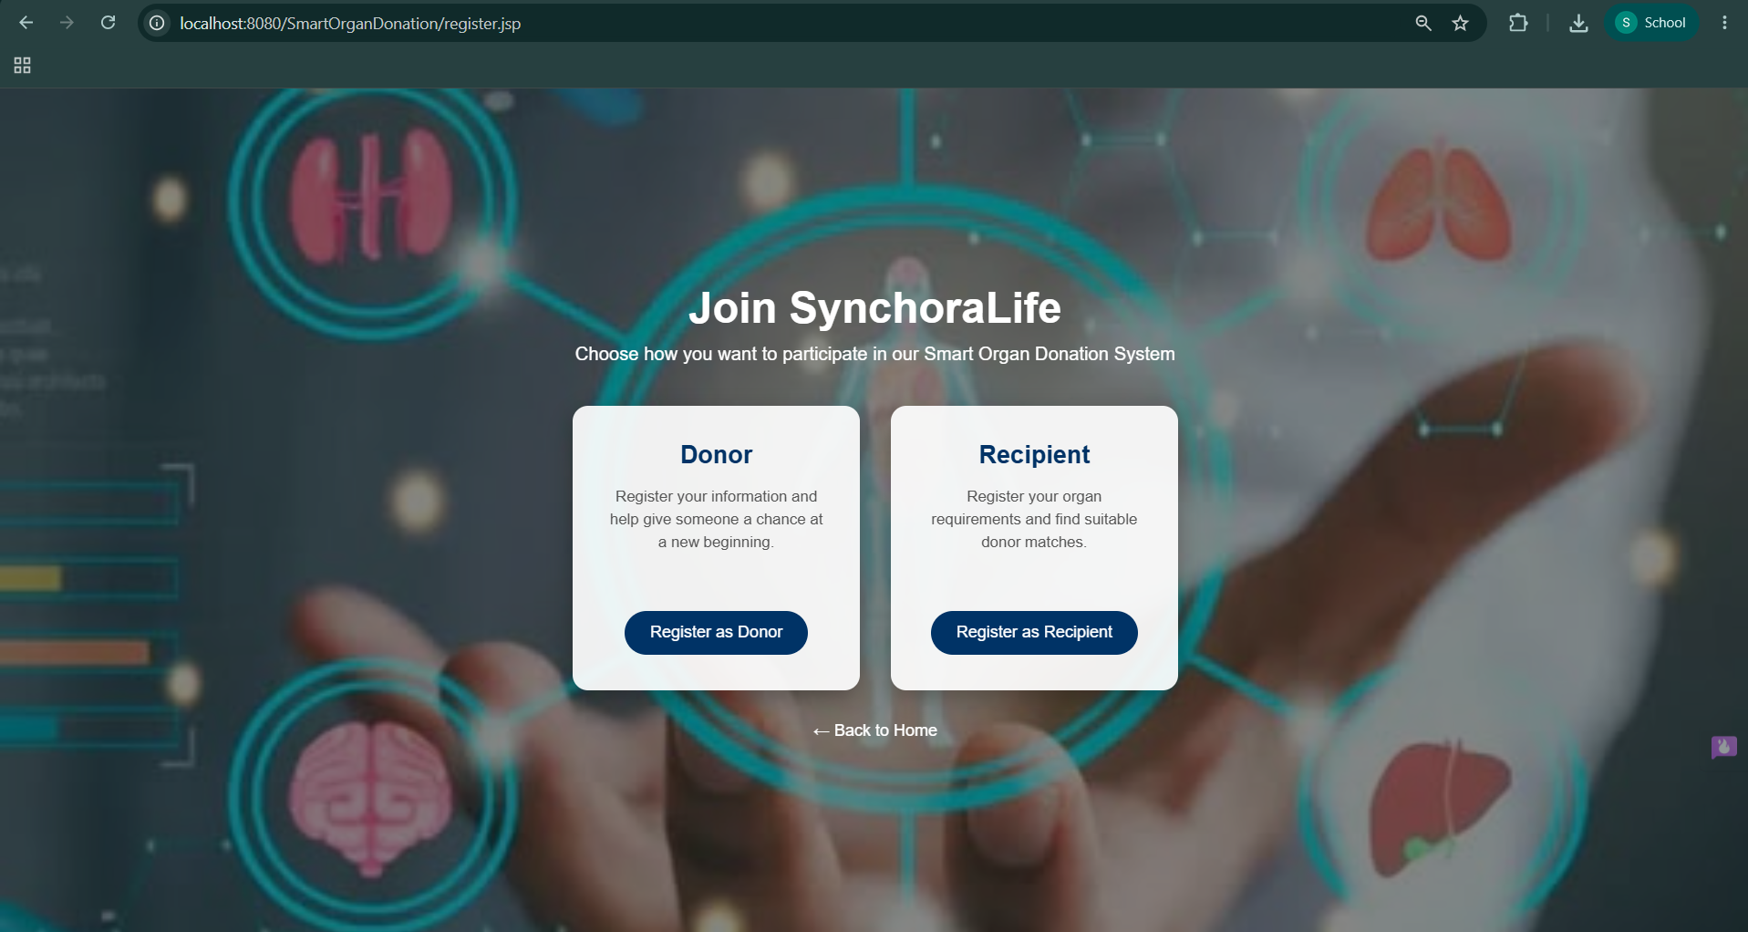
MODULE-1 DONOR and RECIPIENT REGISTRATION and MEDICAL PROFILE MANAGEMENT
Secure Registration: Allows donors and recipients to register with personal details, contact information, blood group, and login credentials.
Medical Profile Management: Stores important medical information such as organ type, health details, urgency level, and donation requirements.
Profile Validation: Validates entered information to reduce incorrect or incomplete medical and personal data.
Centralized Database: Maintains donor and recipient profiles securely in the database for efficient matching and authorized access.

Slide 12
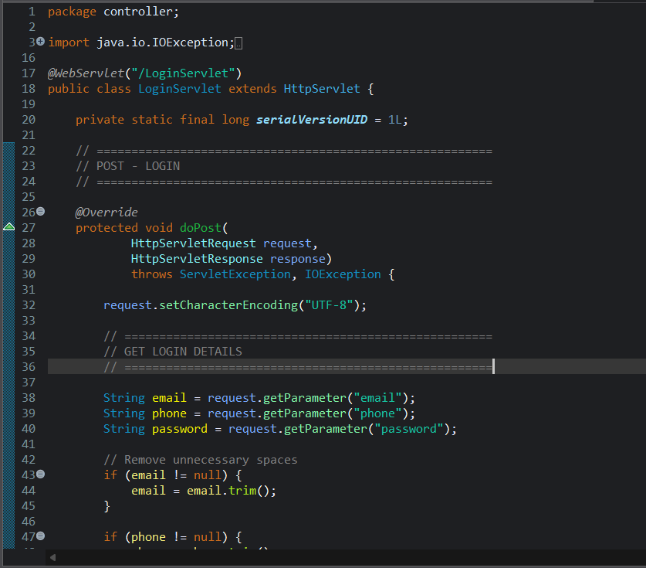
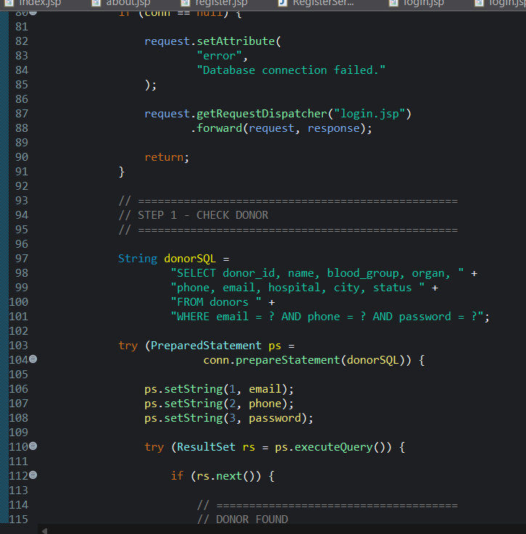
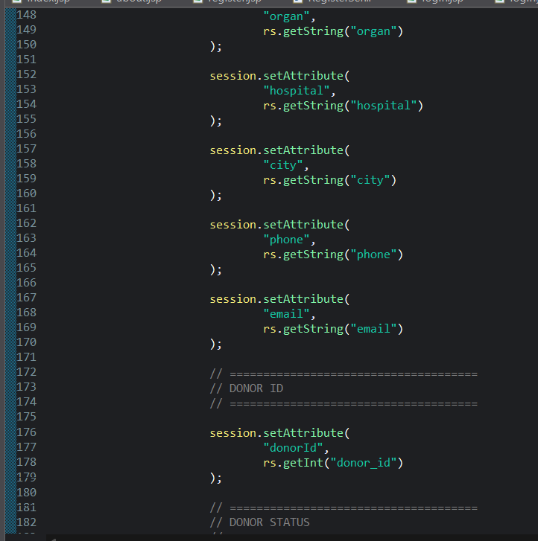
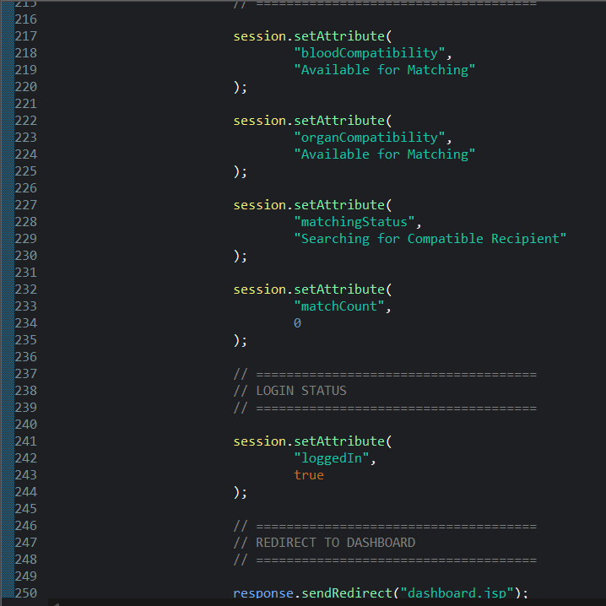
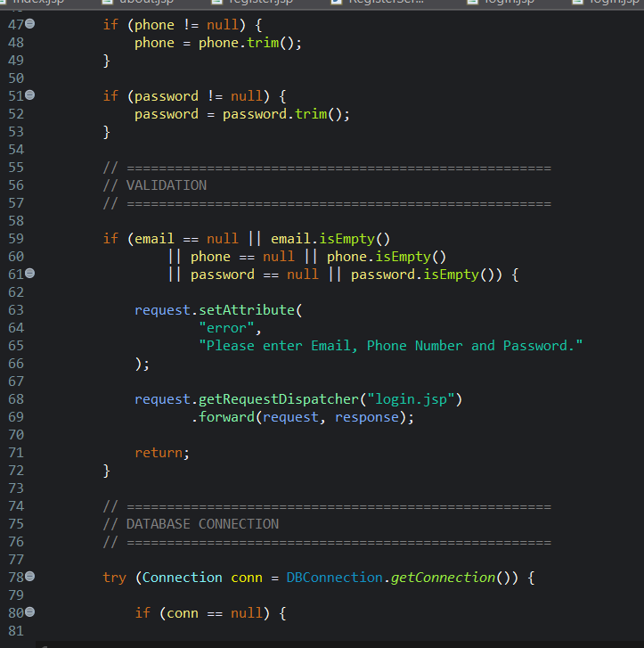
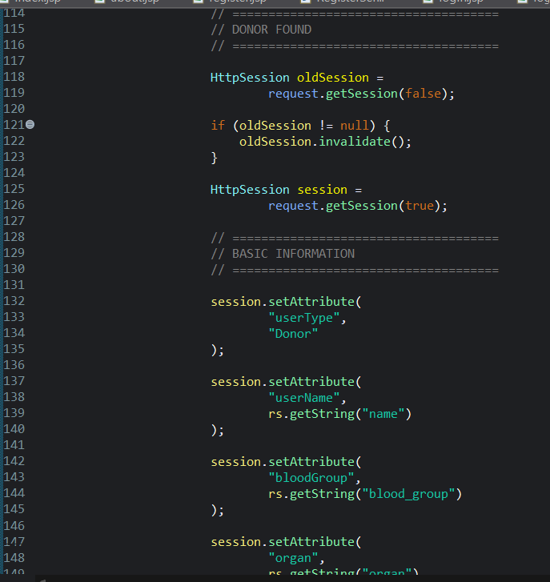
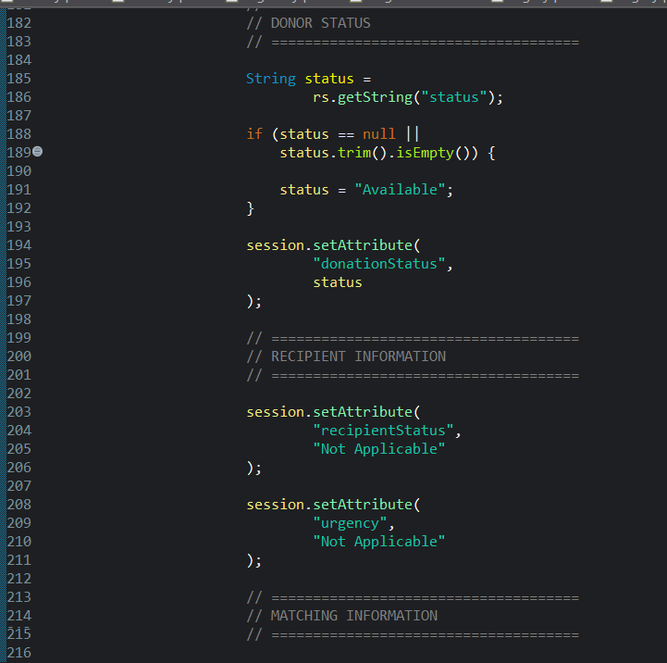
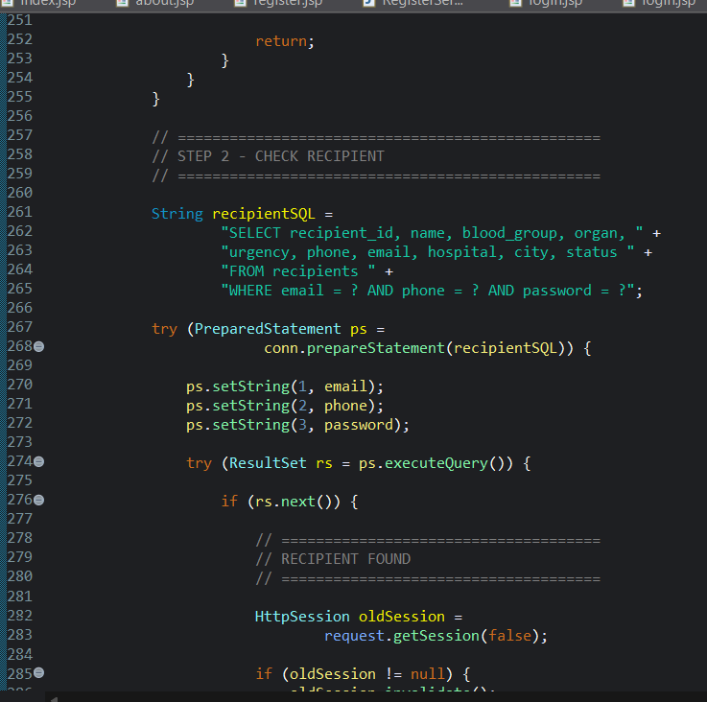
CODE

Slide 13
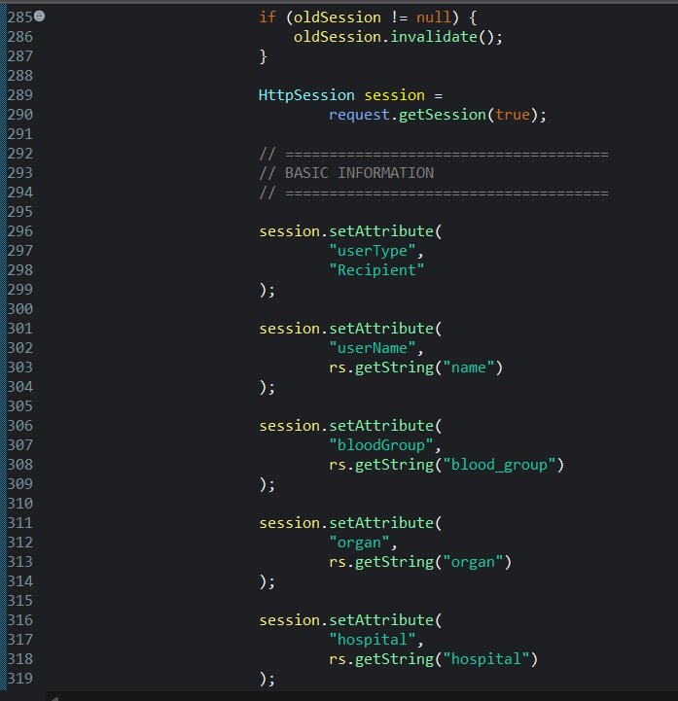
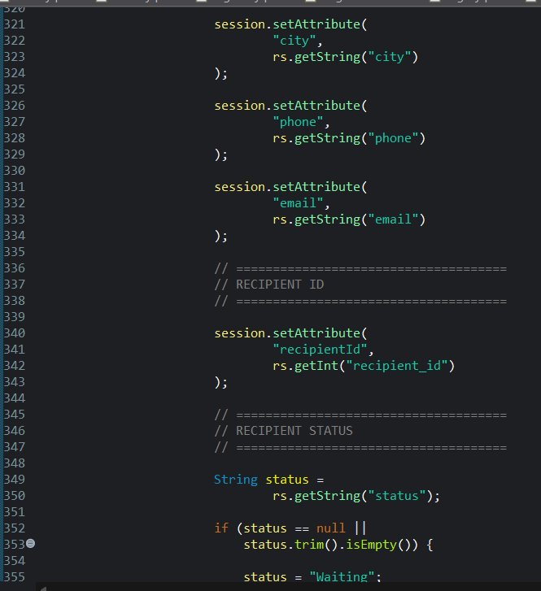
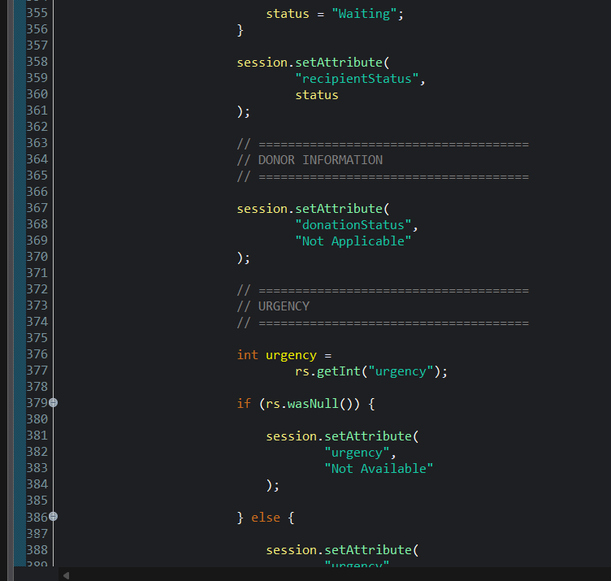
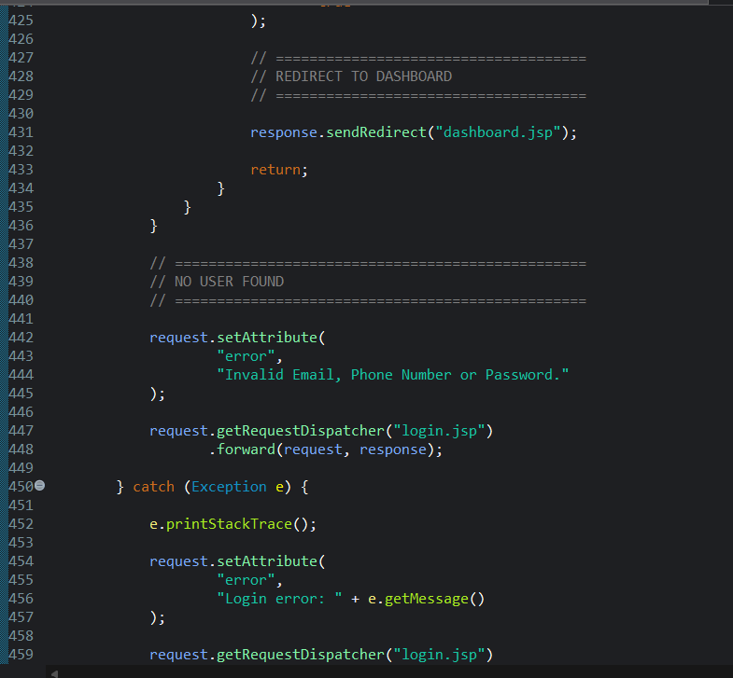
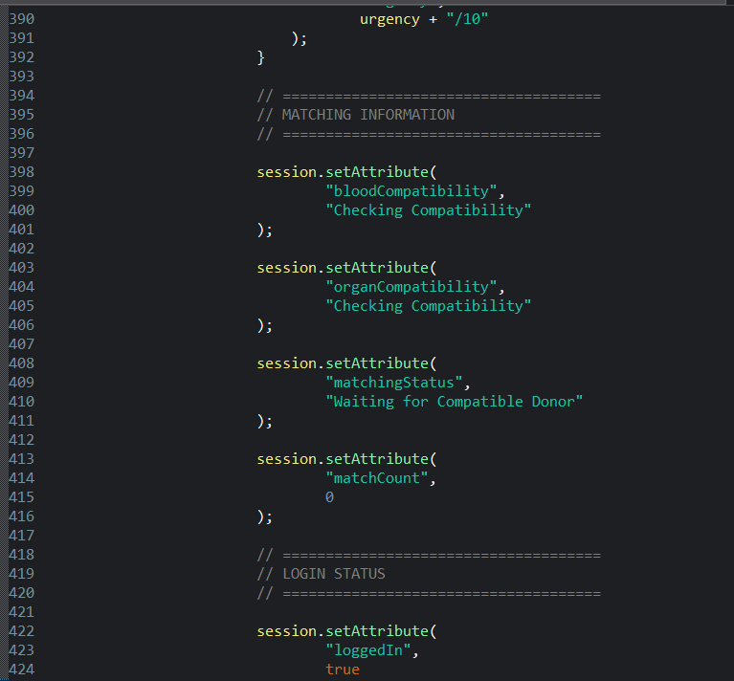
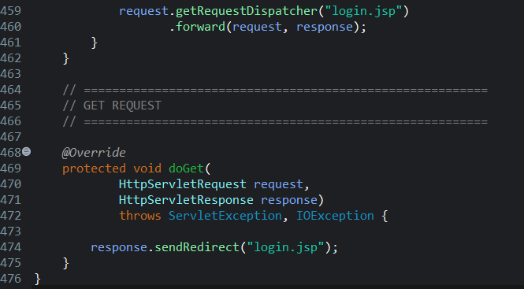

Slide 14
MODULE 2 GRAPH-BASED ORGAN MATCHING and PRIRITY OPTIMIZATION
Secure Registration: Allows donors and recipients to register with personal details, contact information, blood group, and login credentials.
Medical Profile Management: Stores important medical information such as organ type, health details, urgency level, and donation requirements.
Profile Validation: Validates entered information to reduce incorrect or incomplete medical and personal data.
Centralized Database: Maintains donor and recipient profiles securely in the database for efficient matching and authorized access.

Slide 15
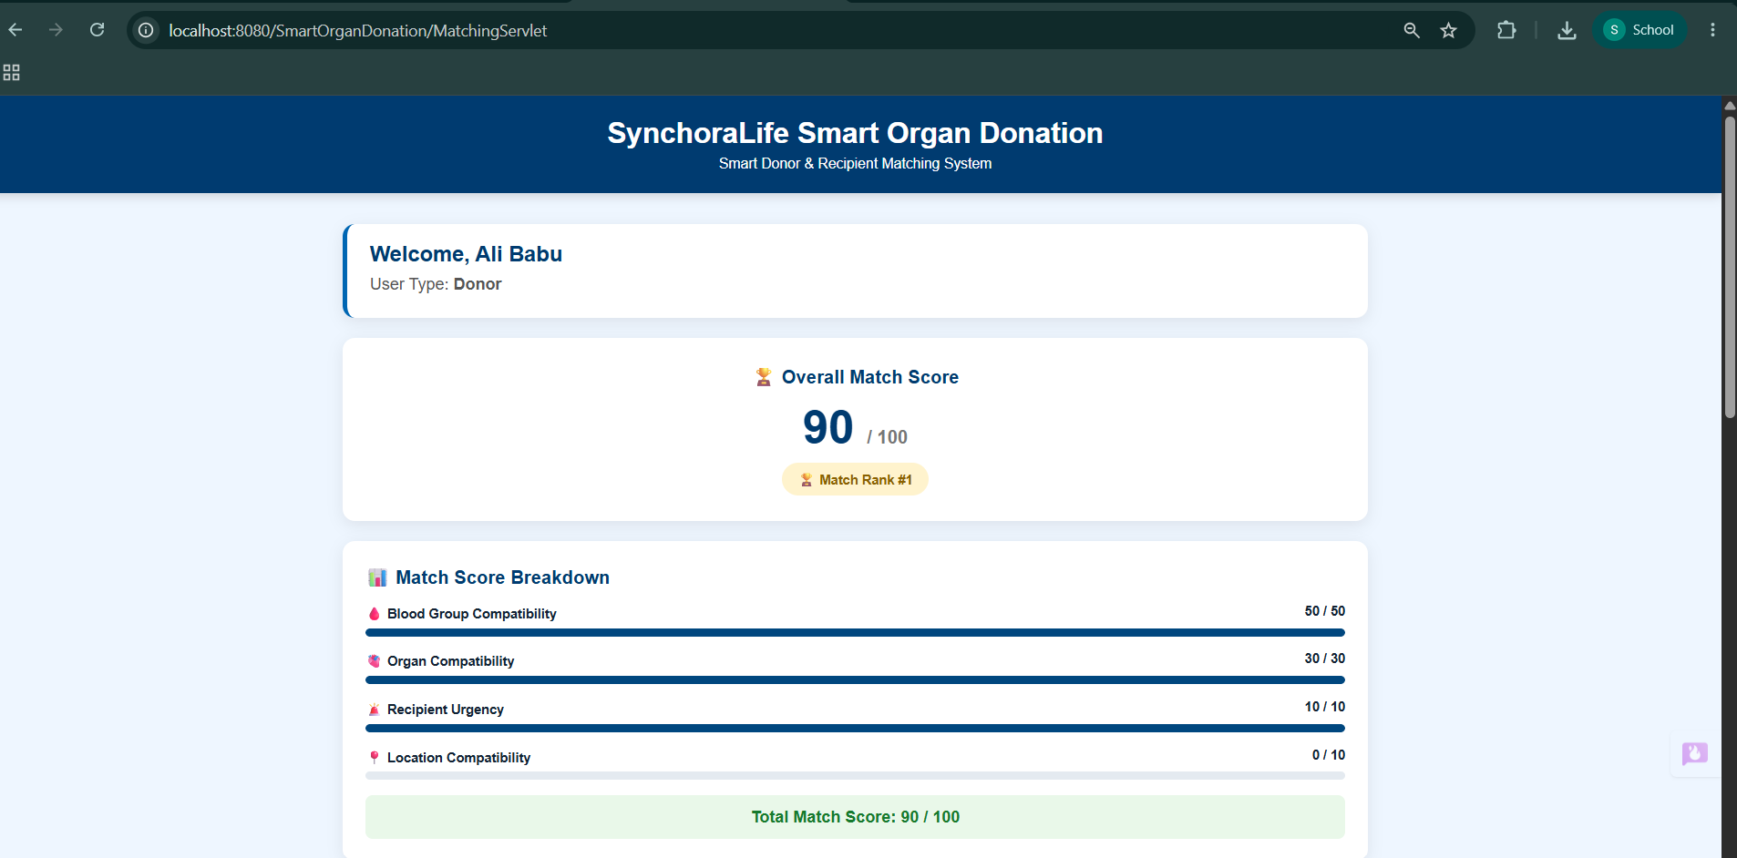
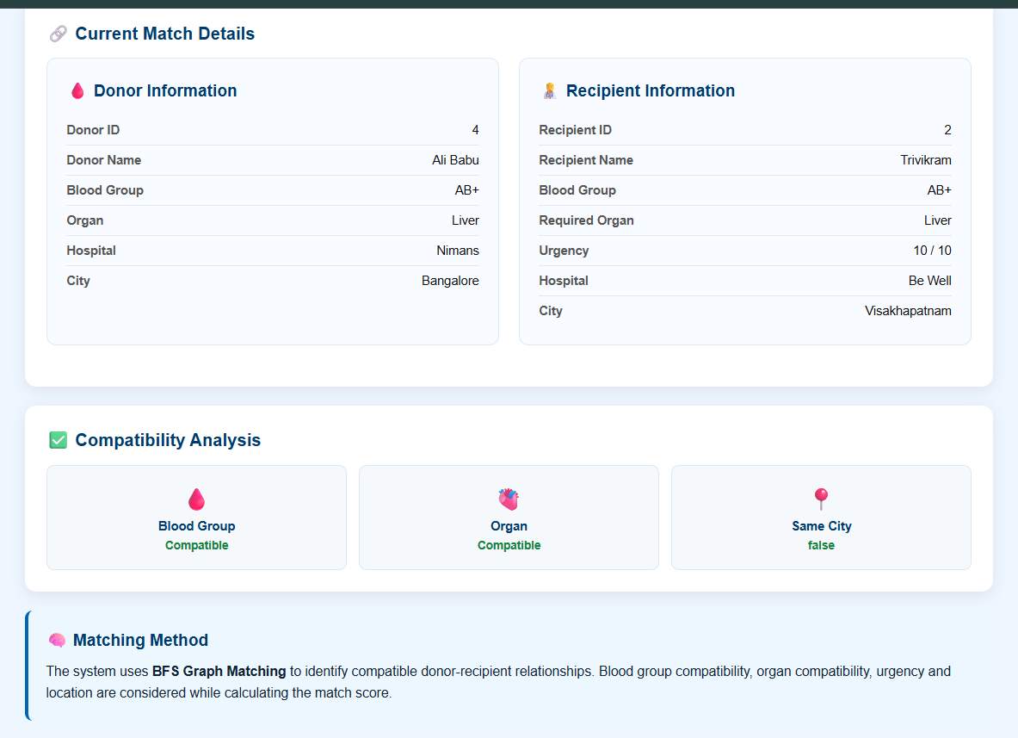

Slide 16
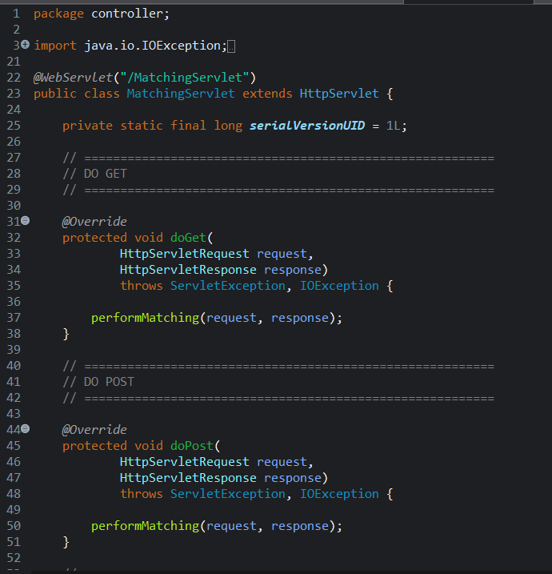
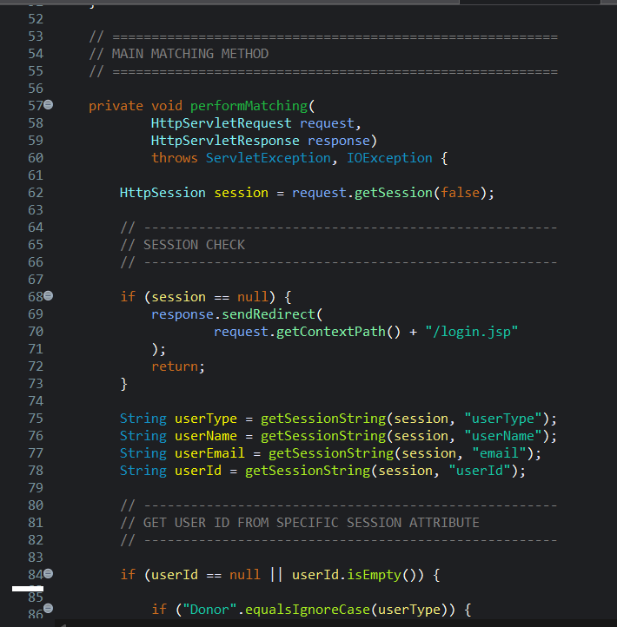
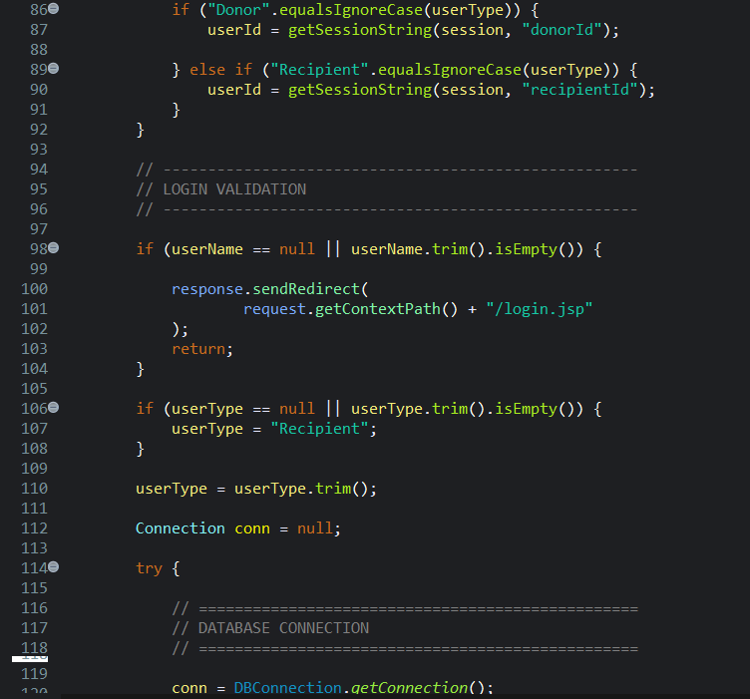
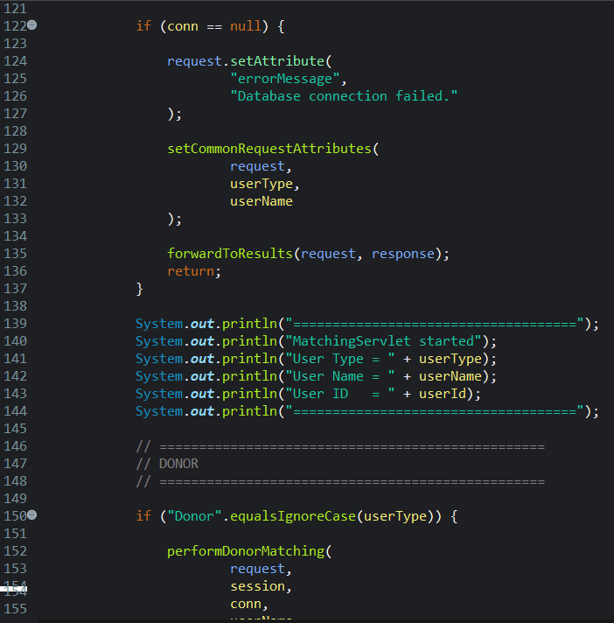
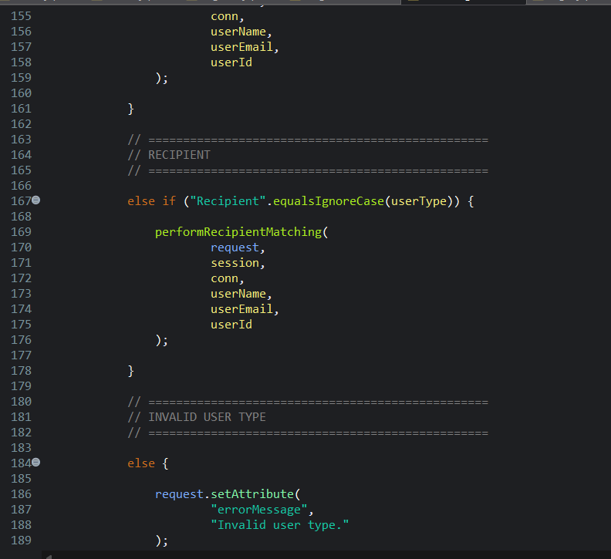
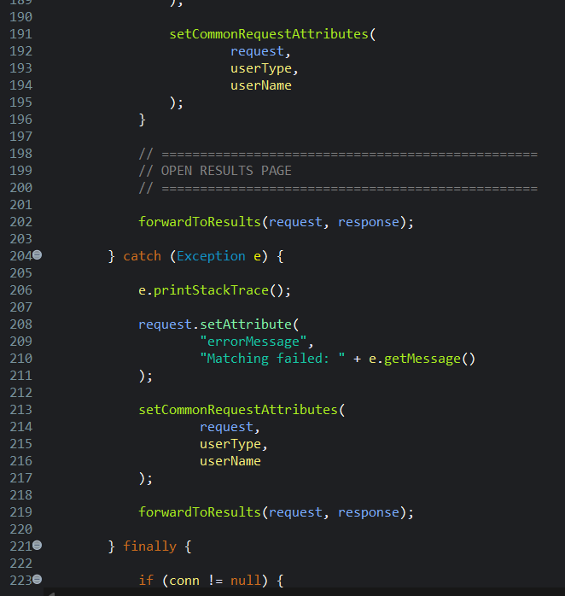
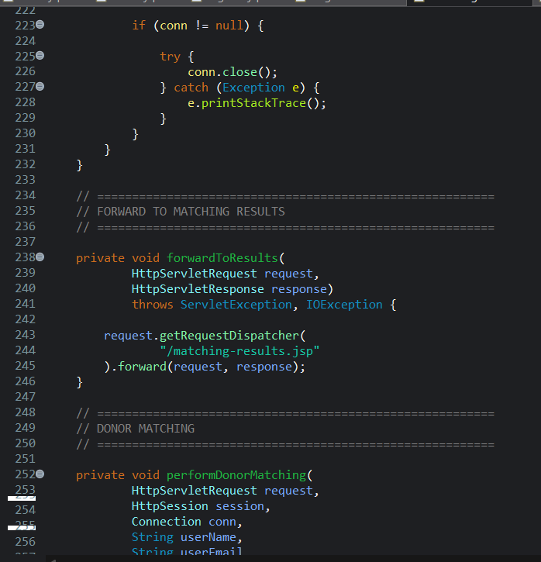
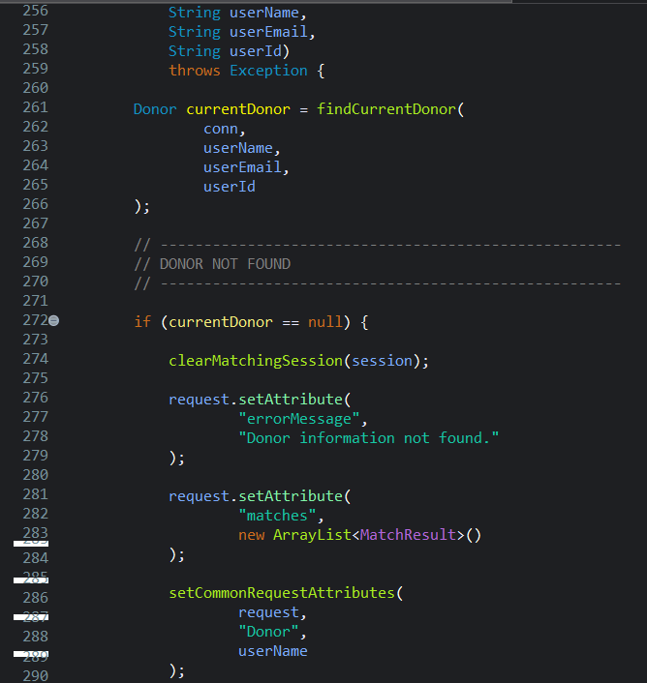
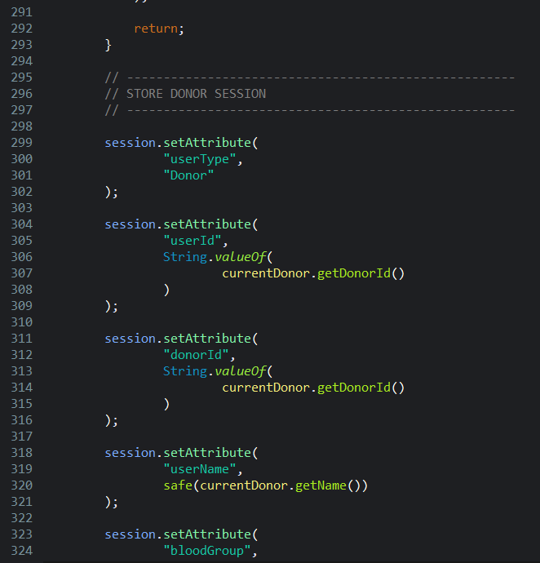
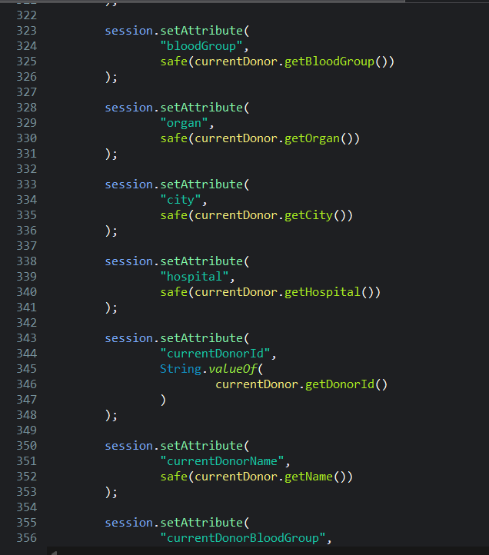
CODE

Slide 17
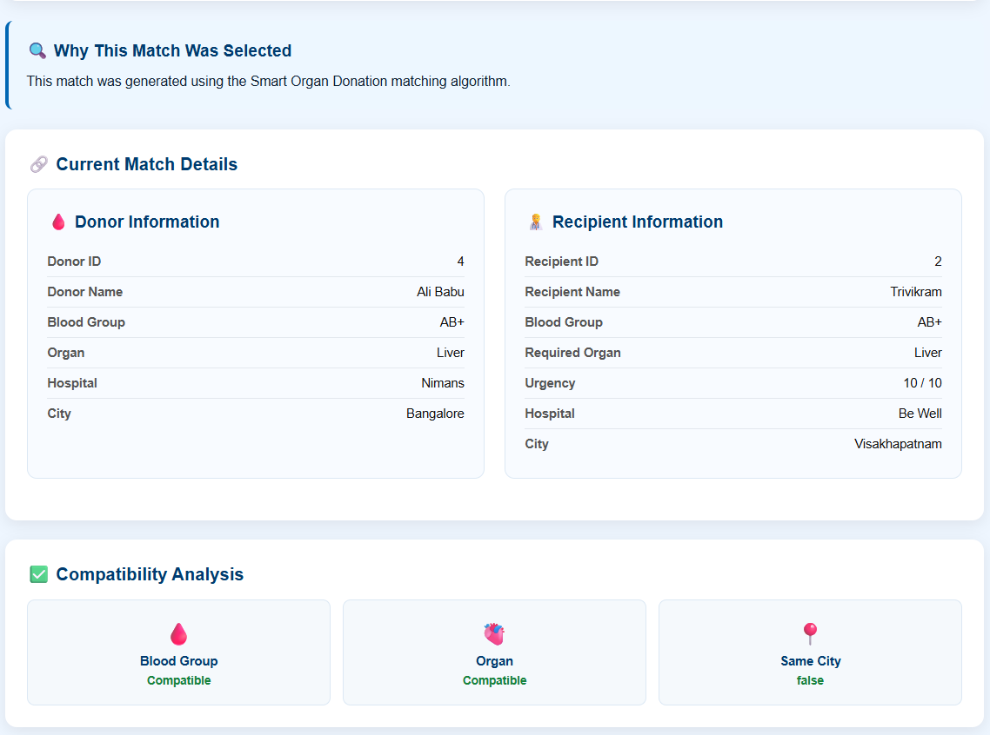
MODULE 3 SMART ORGAN–RECIPIENT ORGAN MATCHING and COMPATIBILITY ANALYSIS
Blood Group Compatibility: Compares donor and recipient blood groups to identify medically compatible matches.
Organ Compatibility: Matches the donor’s available organ with the recipient’s required organ type.
Priority & Urgency Analysis: Considers recipient urgency levels to prioritize patients with greater medical need.
Smart Match Scoring: Combines compatibility factors using graph-based matching and scoring to rank the most suitable donor–recipient pairs.

Slide 18
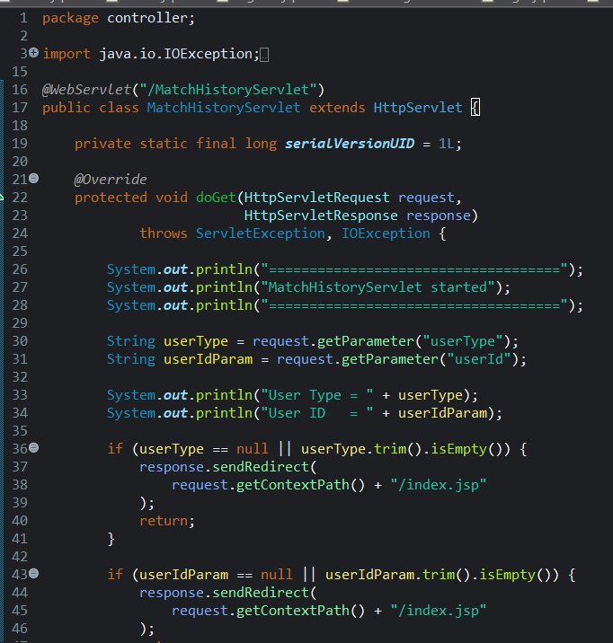
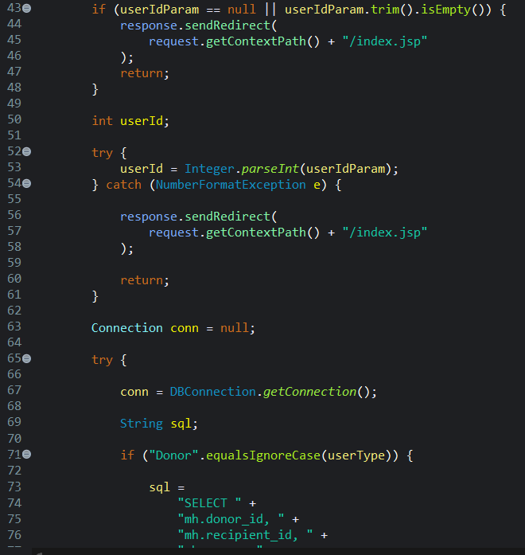
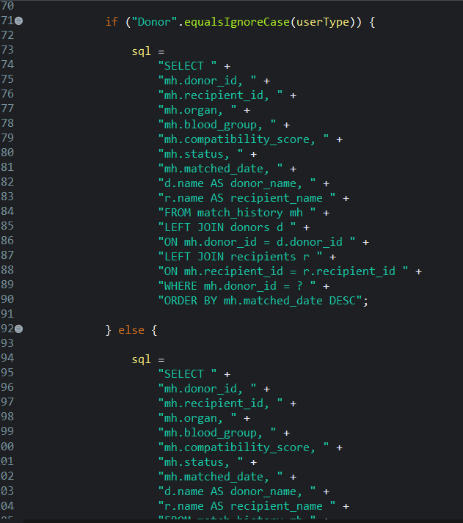
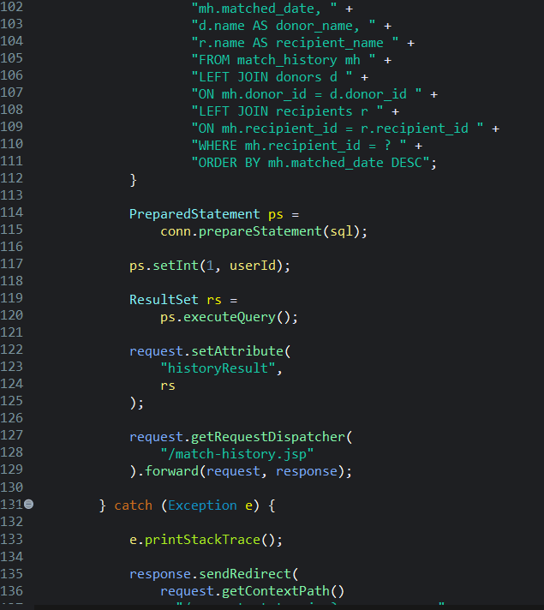
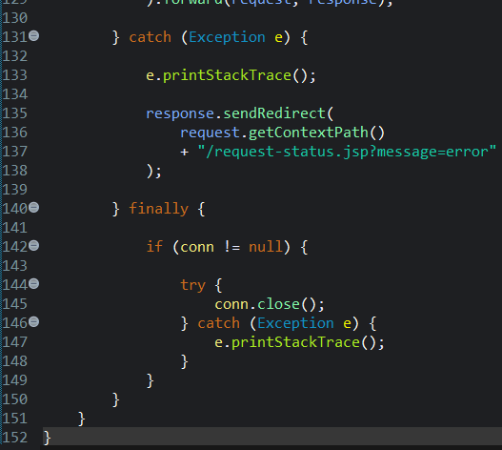
CODE

Slide 19
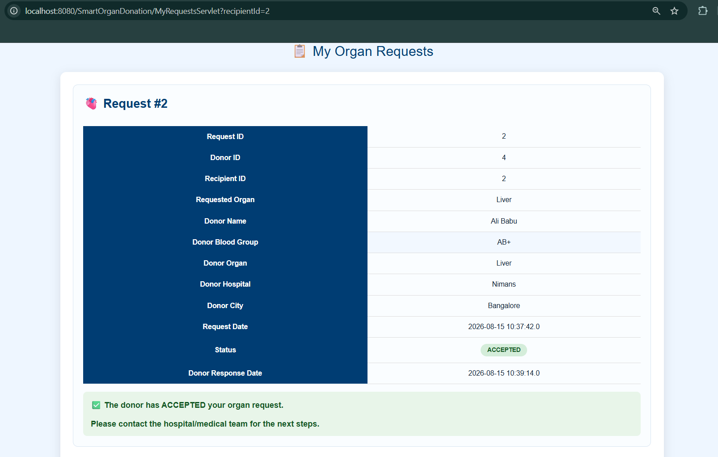
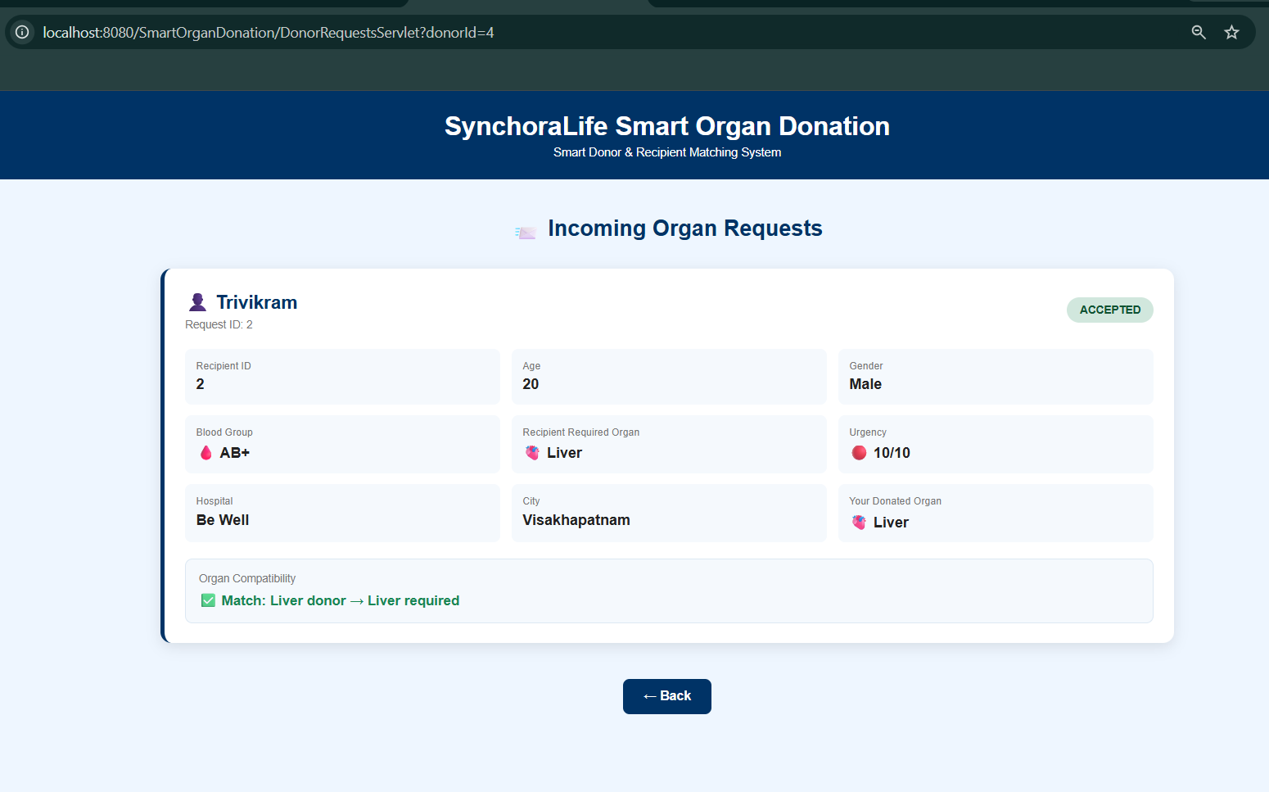
MODULE 4 ORGAN REQUEST, APPROVAL and STATUS MANAGEMENT
Request Submission: Recipients can submit organ requests by specifying the required organ, urgency level, and medical requirements.
Donor Response: Matched donors can review requests and choose to Accept or Reject the request.
Real-Time Status Tracking: The system updates requests as Pending, Accepted, Rejected, or Cancelled.
Request Coordination: Once a suitable donor accepts a request, the system updates the matching status and prevents conflicting multiple acceptances for the same recipient.

Slide 20
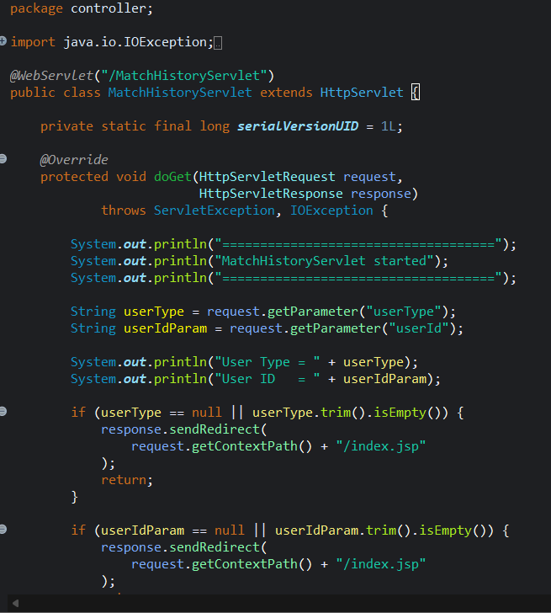
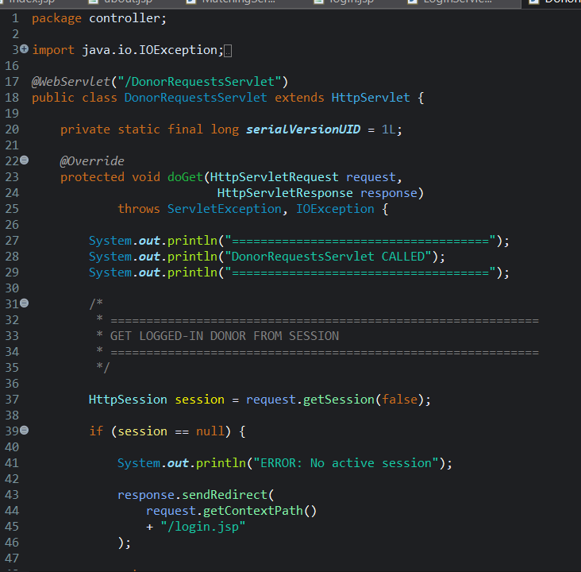
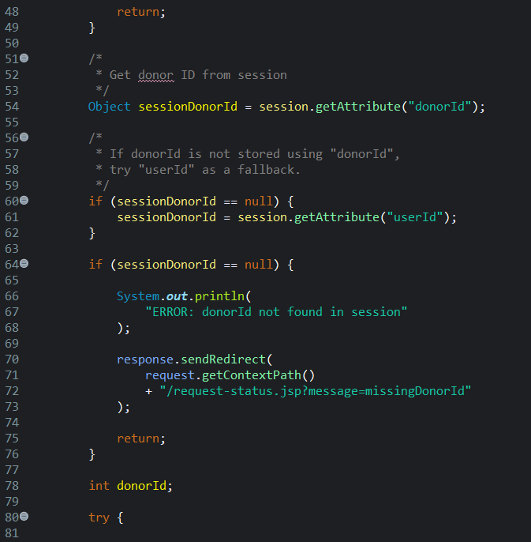
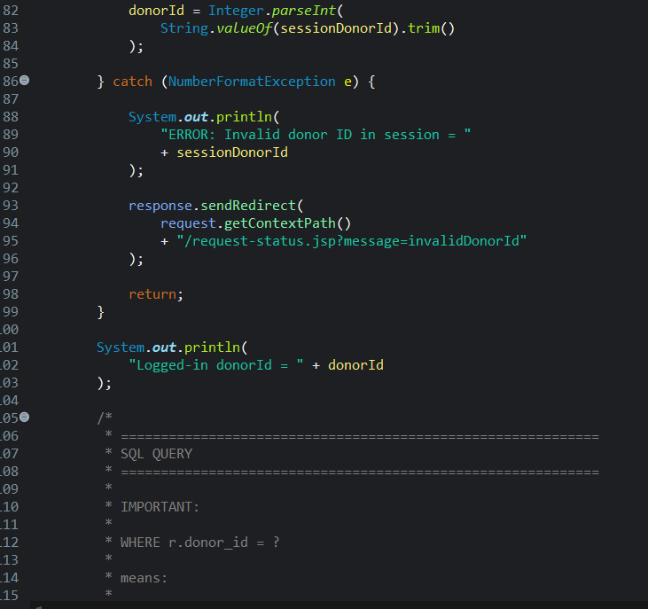
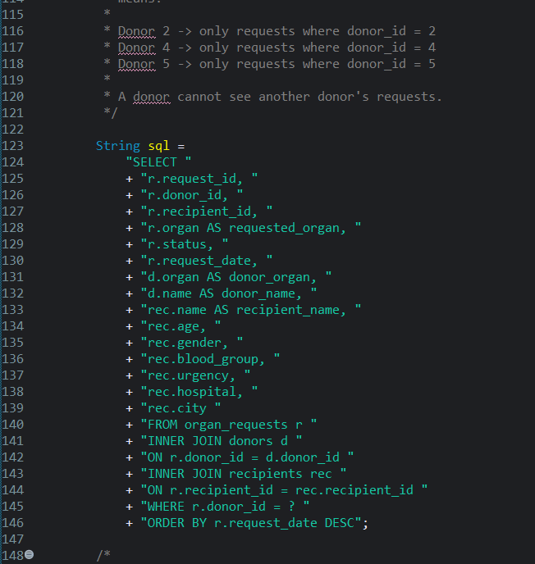
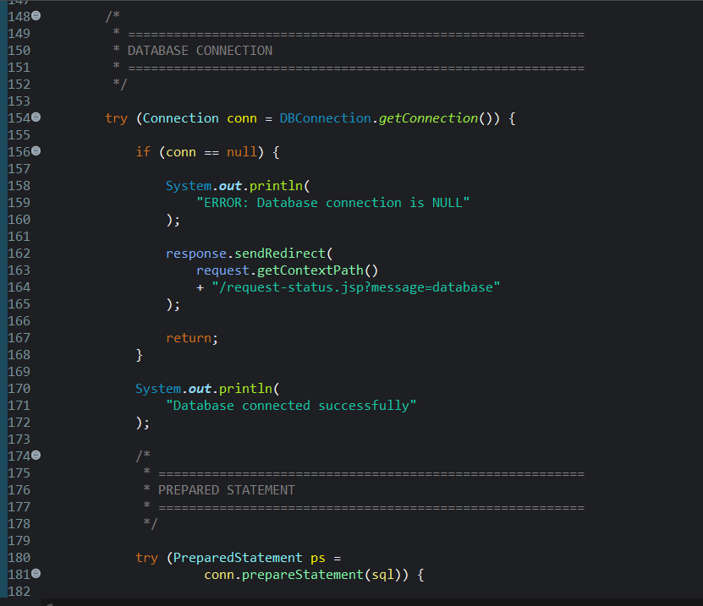
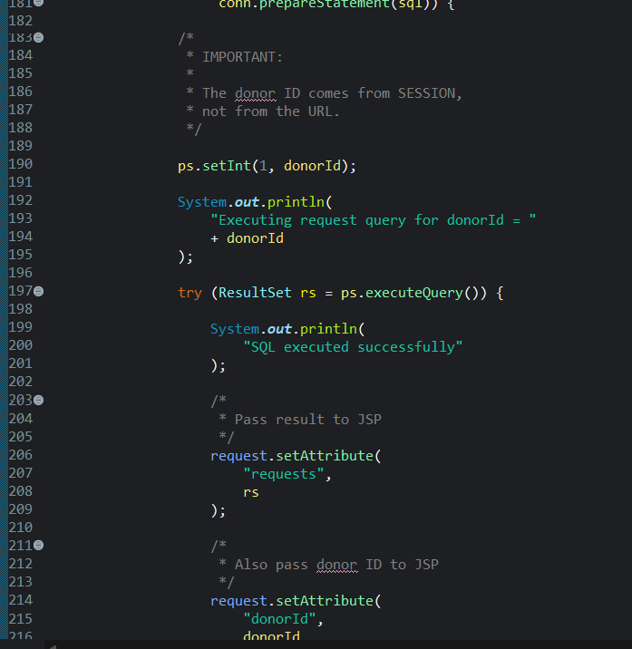
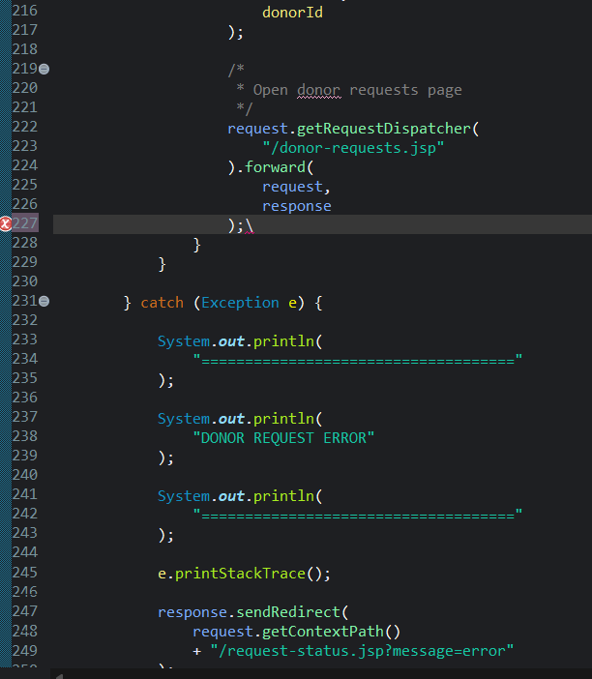
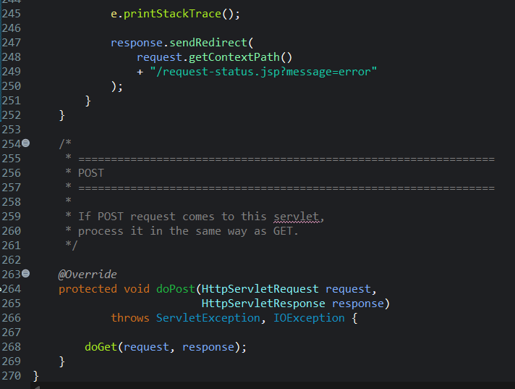
CODE

Slide 21
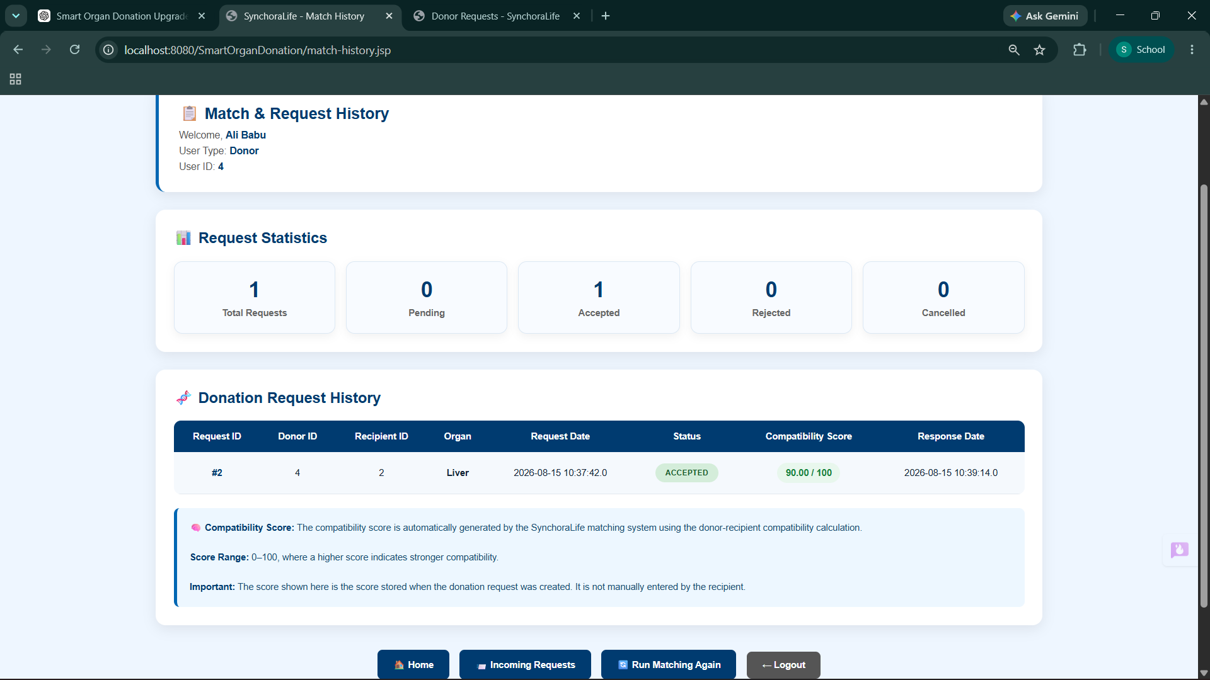
MODULE 5 GRAPH-BASED MATCHING, PRIORITY SCORING and ALLOCATION
Graph Matching: Finds compatible donors and recipients.
Priority Scoring: Ranks matches based on medical needs.
Organ Allocation: Selects the most suitable match.
Status Tracking: Updates the allocation status in real time.

Slide 22
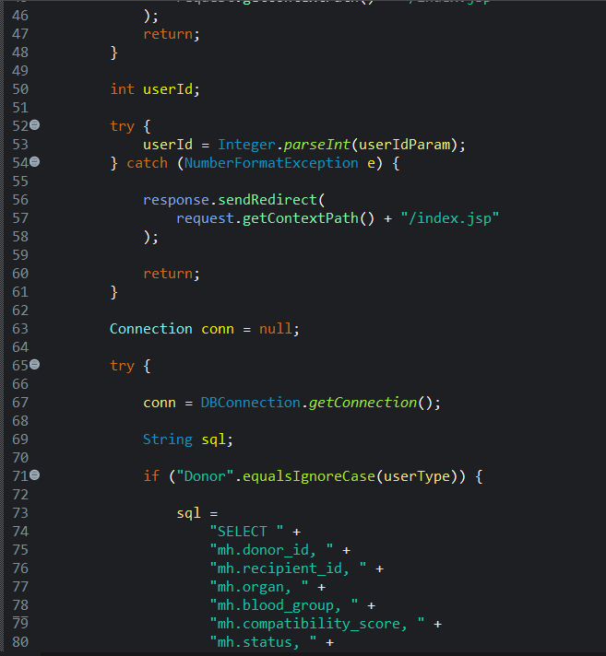
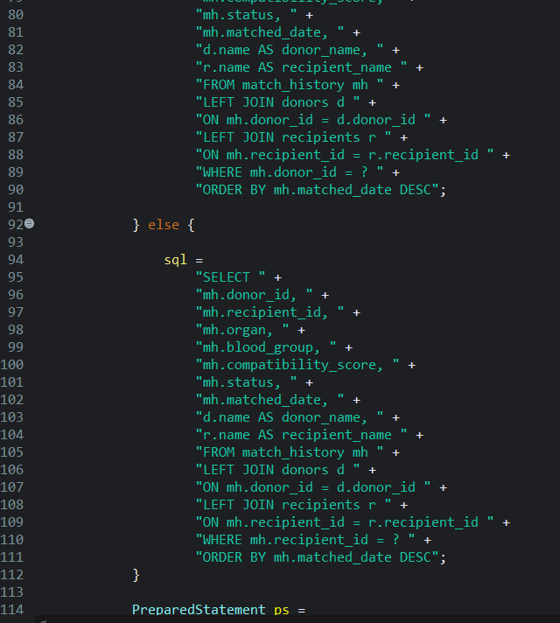
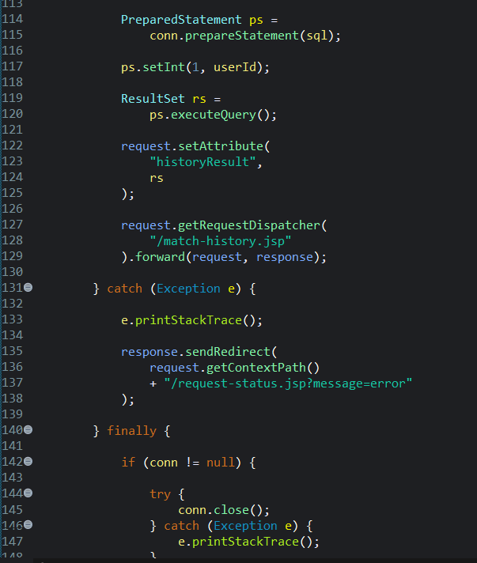

CODE

Slide 23
RESULTS AND RECOMMENDATION
Accurate Matching: The system identifies suitable donor–recipient pairs based on blood group, organ type, urgency, and location compatibility.
Faster Allocation: The graph-based matching process reduces manual effort and helps identify suitable donors more quickly.
Priority-Based Selection: Recipients with higher medical urgency are prioritized to support timely and effective organ allocation.
Recommended Improvement: The system can be enhanced with real-time hospital coordination, advanced medical criteria, and improved matching algorithms for more accurate allocation.

Slide 24

OUTPUT
Fig-1 -Index Page

Slide 25


OUTPUT
Fig-2 –Dashboard

Slide 26


OUTPUT
Fig-3 –REGISTERATION

Slide 27


OUTPUT
Fig-4 –MATCHING ORGAN

Slide 28


OUTPUT
Fig-5 –Recipient Request and Donor Reply

Slide 29




OUTPUT
Fig-6 –ADMIN PORTAL

Slide 30



OUTPUT
Fig-6 –ADMIN PORTAL

Slide 31




OUTPUT
Fig-7 –ABOUT PAGE and CONTACT PAGE

Slide 32
CONCLUSION
Efficient Matching: The system provides fast and accurate donor–recipient matching based on important compatibility factors.
Priority-Based Allocation: The system gives higher priority to recipients with greater medical urgency.
Reduced Manual Effort: Graph-based algorithms simplify the matching process and reduce time-consuming manual work.
Improved Organ Donation: The system supports transparent, reliable, and efficient organ allocation for better donation management.

Slide 33
FUTURE SCOPE
Advanced Medical Matching: Incorporate additional medical factors such as tissue compatibility, age, and clinical condition for more accurate matching.
AI-Based Prediction: Use artificial intelligence and machine learning to predict suitable matches and improve allocation decisions.
Mobile Application: Develop a mobile application to allow donors, recipients, hospitals, and administrators to access the system anytime.
Cross-City Organ Tracking: Track the organ’s movement between different cities and hospitals to ensure safe, timely, and transparent transportation.

Slide 34
R REFERENCE
Roy, Siddhartha, Subhajit Ghosh¹, and Sandip Mandal. "Designing a Blockchain and IoT-Based Framework for Real-Time Organ Donation." Data Mining and Information Security: Proceedings of ICDMIS 2025, Volume 2 2 (2026): 365.
Duggegowda, D. (2025). AI empowered federated learning approach with blockchain for secure and transparent EHR based organ donation network. International Journal of System Assurance Engineering and Management, 1-18.
Bawa, Geet, and Hardeep Singh. "Revolutionizing Organ Transplantation Logistics through Blockchain, Smart Contracts, and Internet of Medical Things-driven System." Indian Journal of Transplantation 20, no. 2 (2026): 183-195.
Sharma, H., Yadav, D., Agrawal, K., Panwar, A., & Singh, G. (2026, February). Organixis: Blockchain Based Organ Donation System. In 2026 International Conference on Computing, Sciences and Communications (ICCSC) (pp. 1-6). IEEE.
Wagh, Rajneel, Atharva Rajpurkar, Pooja Makhijani, and Nabanita Mandal. "Analysis of Organ Donation Willingness in India: a Counterfactuals Approach." In 2026 4th International Conference on Intelligent Data Communication Technologies and Internet of Things (IDCIoT), pp. 1609-1615. IEEE, 2026.

Slide 35


